Slide 1
ITP20005
Good Programming /
Racket Basics (1)
Lecture02
JC

Slide 2
Quiz1 answers from students
"I want to know how programming code changes into machine language" ⇒ This is what compilers do!! "...want to learn a racket language…" ⇒ Racket is just a tool to study PL theories. "Understanding the principles of PL is important to not only learn other languages but also understand how the program works…" "...want to know how programming language is being made…"

Slide 3
Quiz1 answers from students
"...PL will not disappear unless the form or the medium might be changed…" "...new PL can appear…" "...PL will be same as our verbal language…" "...in the future, computers can fully understand human languages…we don't need any PL in that day..." "...programmers will disappear as AI can replace them. but PLs cannot be replaced..." ⇒ https://www.wired.co.uk/article/google-ai-language-create "...I want to learn new language…" ⇒ We learn language principles which will help you learn new language quickly! "...learn structures of many other languages…" ⇒ We learn a common notation (BNF) to understand language structures. "...PL history" ⇒ https://upload.wikimedia.org/wikipedia/commons/2/25/Genealogical_tree_of_programming_languages.svg

Slide 4
Fish <-> Software
How to fish <-> How to implement software
A fishing rod/tools <-> A programming language → By studying the detailed features of the fishing rod/tools, we can learn how we can fish well. We can easily use other kinds of fishing rods when having enough understanding and experiences about the detailed features of the fishing rod. We can even design the best fishing rod!
→ By studying the detailed features of the programming language, we can learn how we can implement software well. We can easily use other PLs when having enough understanding and experiences about the detailed features of the programming language. We can even design our own programming language!!

Slide 5
Teaching approach for this PL class
By implementing interpreters
Write programs to learn concepts.
We are going to use Racket (formerly Scheme) and variants
Textbook (Free Ebook, Version 2007-04-26)
Programming Languages: Application and Interpretation
Shriram Krishnamurthi (Brown University)
http://www.plai.org First Edition
Another approach we partially adopt
Survey approach
Good to learn the consequences of languages.
Others
Definitional interpreter approach
Rigorous approach

Slide 6
Big Picture (modeling languages)
Just write an interpreter to explain a language.
By writing an interpreter, we can understand the language!
Interpreter can be converted into a compiler!!!
A program
Interpreter running on a computer
Results
Parser
Another program that can directly run on a computer
Compiler
Running on a computer
Notes:
Interpreter is who know a language very well!

Slide 7
What do we learn?

Slide 8
Topics we cover and schedule (tentative)
Racket tutorials (L2,3)
Modeling languages (L4,5)
Interpreting arithmetic (L5)
Language principles
Substitution (L6)
Function (L7)
Deferring Substitution (L8, L9, HW)
First-class Functions (L10-L12)
Laziness (L13,14)
Recursion (L15,16)
Mutable data structures (L17,18)
Variables (L19,L20)
Continuations (L21,22,23)
Garbage collection (L24)
Semantics (L25)
Type (L25,26)
Guest Video Lecture (L28)
No class: October 2 (Fri, Chuseok), October 9 (Fri, Hangul day) Online only class can be provided.

Slide 9
What is a computer program?

Slide 10
What is good programming?

Slide 11
Tinker until it works????

Slide 12
What is good programming?
The creation of software that relies on SYSTEMATIC thought, planning, and understanding...

Slide 13
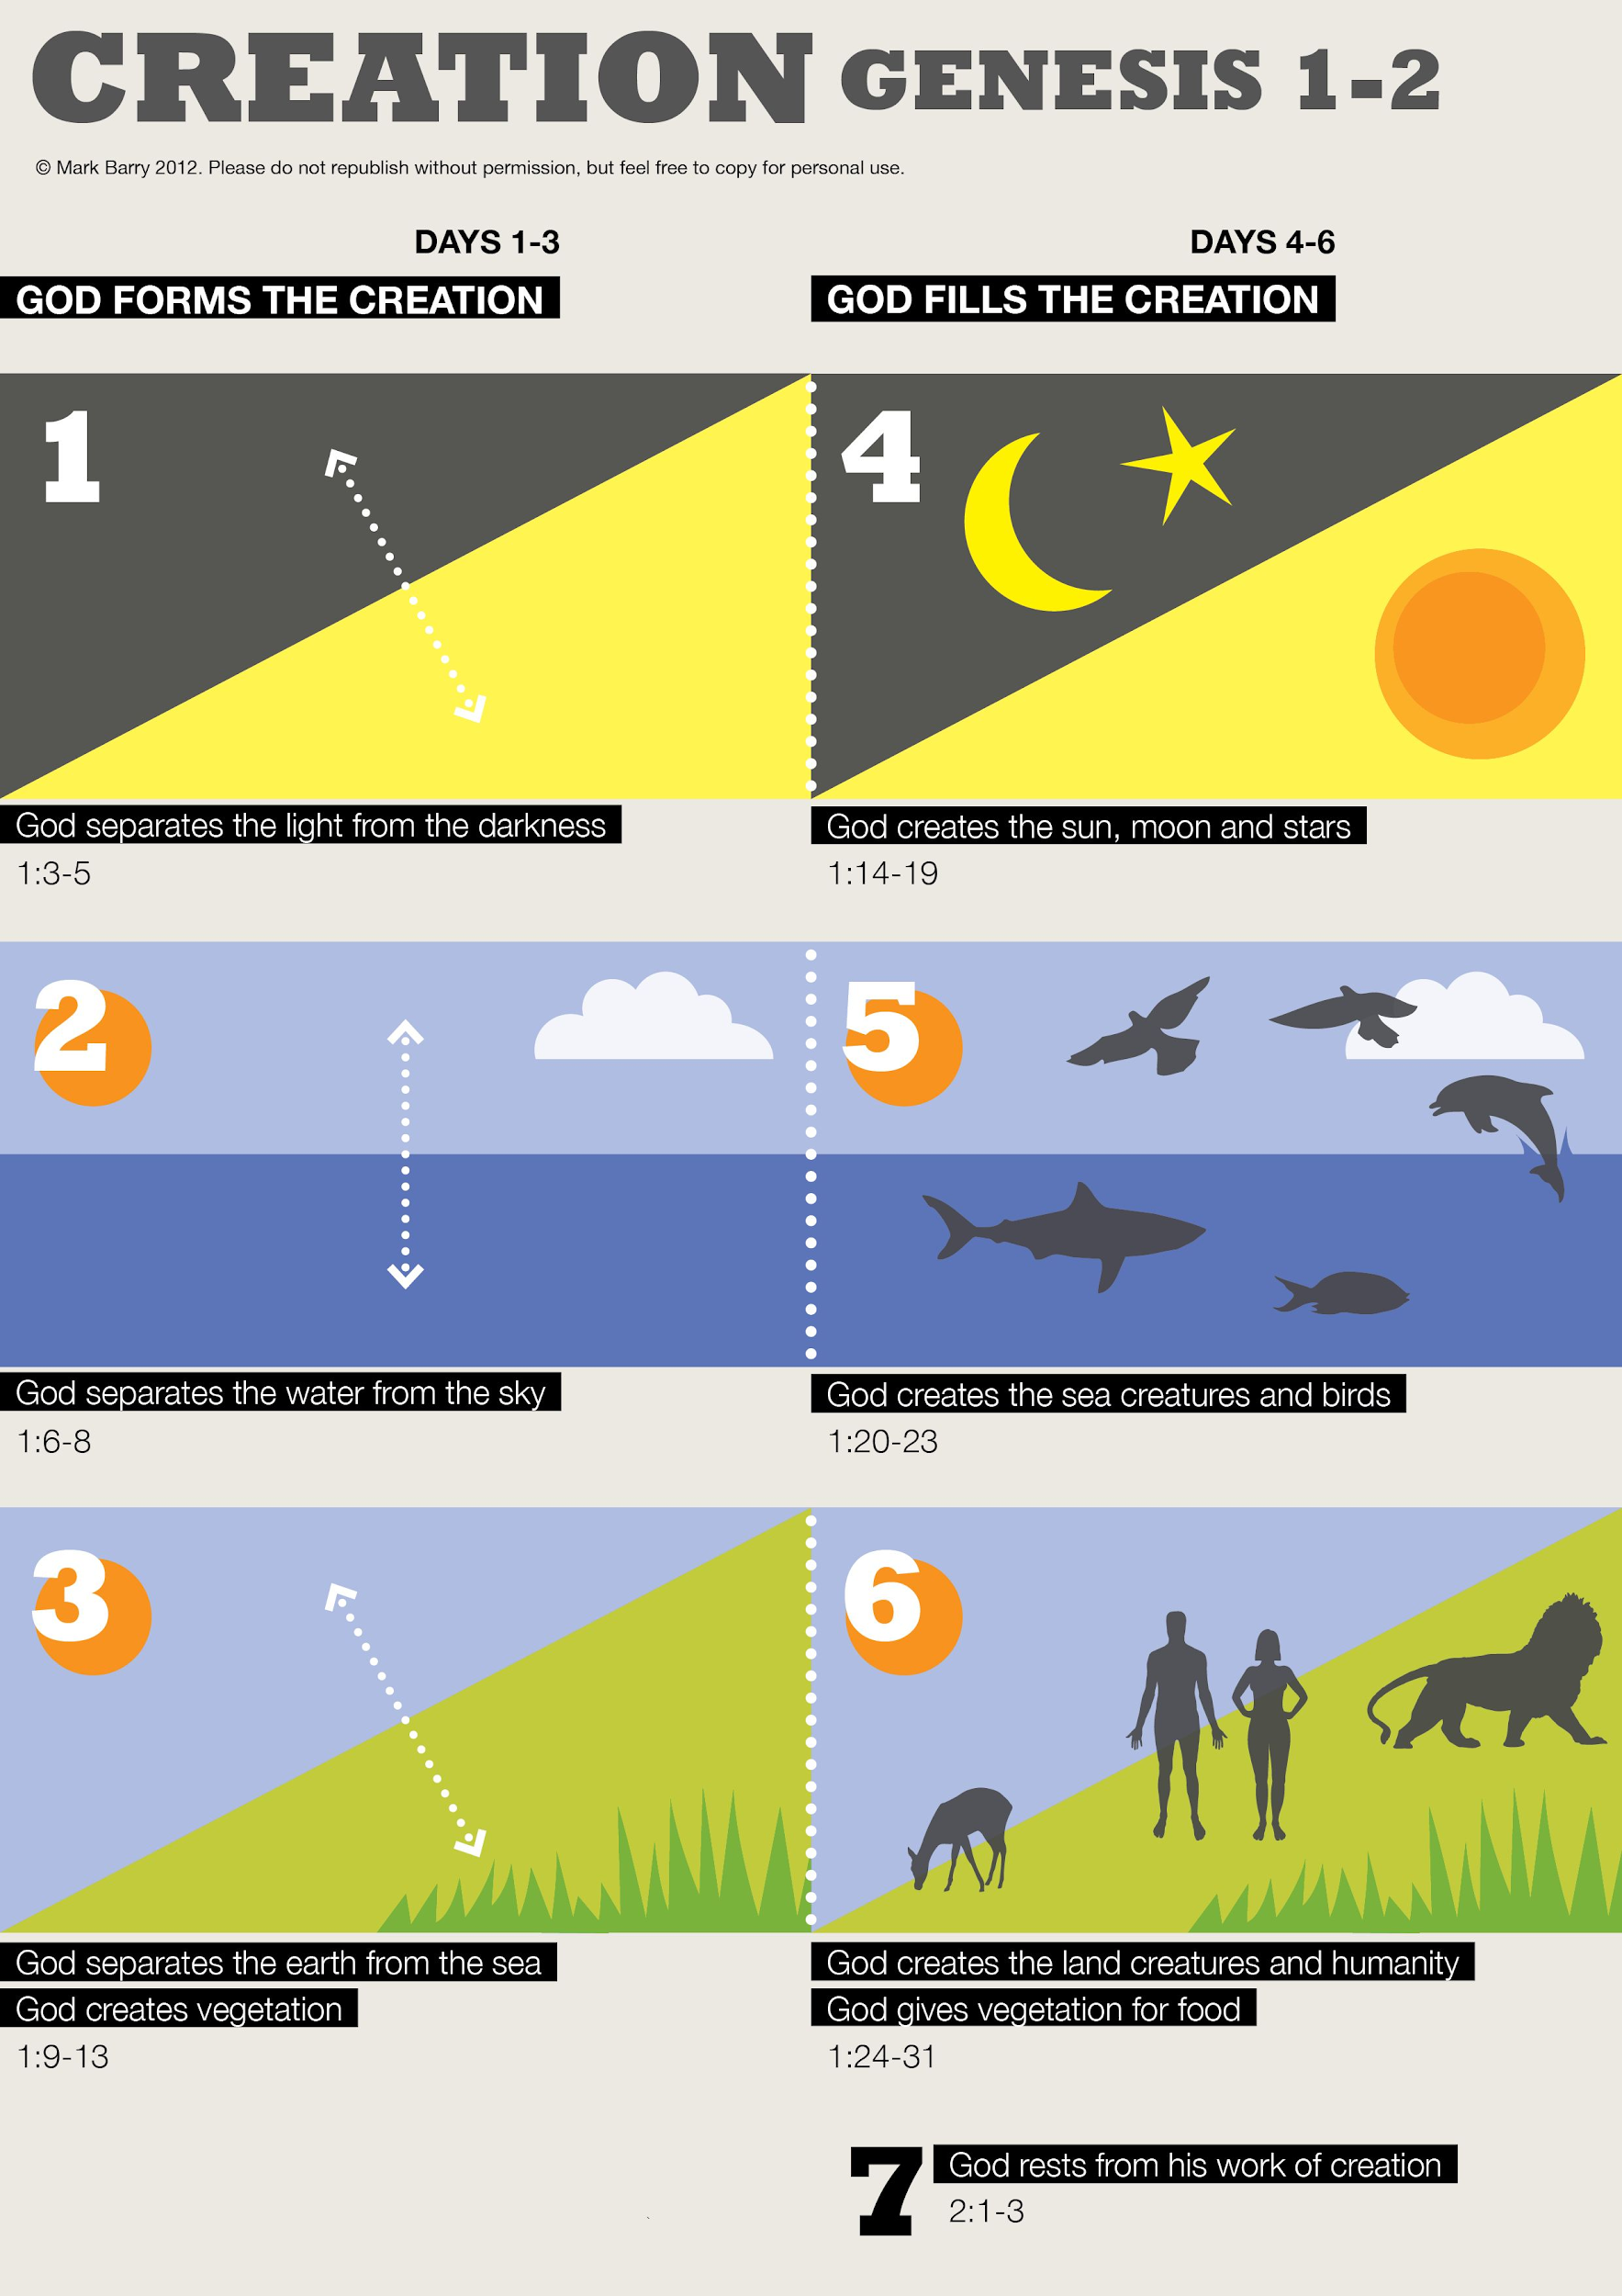
What is good programming?
The creation of software that relies on SYSTEMATIC thought, planning, and understanding...

Slide 14
Phases until a program runs

Slide 15
Until a program works...
[Design a program]
→ [Write the program by a programming language]
→ [Interpret or compile the program]
→ [Run it and see the results]

Slide 16
Elements for Systematic Program Design
Problem Analysis and Data Definitions
Contract (Signature), Purpose (Effect) statement, Header
Functional Examples
Function Definition
Testing

Slide 17
Until a program works...
[Design a program]
→ [Write the program by a programming language]
→ [Interpret or compile the program]
→ [Run it and see the results]

Slide 18
Programing Languages (by Krishnamurthi)
Peculiar syntax (c.f. grammar = syntax + morphology)
Some behaviors associated with each syntax
Numerous useful libraries
A collection of idioms that programmers of that language use
Grammar vs. Syntax in the view of natural language: https://orbi.kr/0003544888

Slide 19
Until a program works...
[Design a program]
→ [Write the program by a programming language]
→ [Interpret or compile the program]
→ [Run it and see the results]

Slide 20
Interpreters and Compilers
An interpreter takes a program and produces a result
bash
Racket
Search engine (Google, Naver,...)???
A compiler takes a program and produces a (binary) program
gcc
javac
Racket

Slide 21
Big Picture
A program
Interpreter running on a computer
Results
Parser
Another program that can directly run on a computer
Compiler
Running on a computer
Notes:
Interpreter is who know a language very well!

Slide 22
Understand preliminary language elements for computers
(in Racket)

Slide 23
What kinds of PL elements exist for Computers? (e.g., variable,...)

Slide 24
Basic programming language elements
(used in this class and Racket)
Numbers and Arithmetic
Variables and Functions
Conditional Expressions
Conditional Functions
Symbols

Slide 25
DrRacket
Our programming language to study PL
Install Dr. Racket
http://racket-lang.org/
Language level: plai (https://docs.racket-lang.org/plai/index.html)
Each file should be prefixed with: #lang plai
Example
Type the following in the Definitions window: #lang plai ; this is a comment line (define (area-of-square a) (* a a)) (test (area-of-square 4) 16)
Click Run

Slide 26
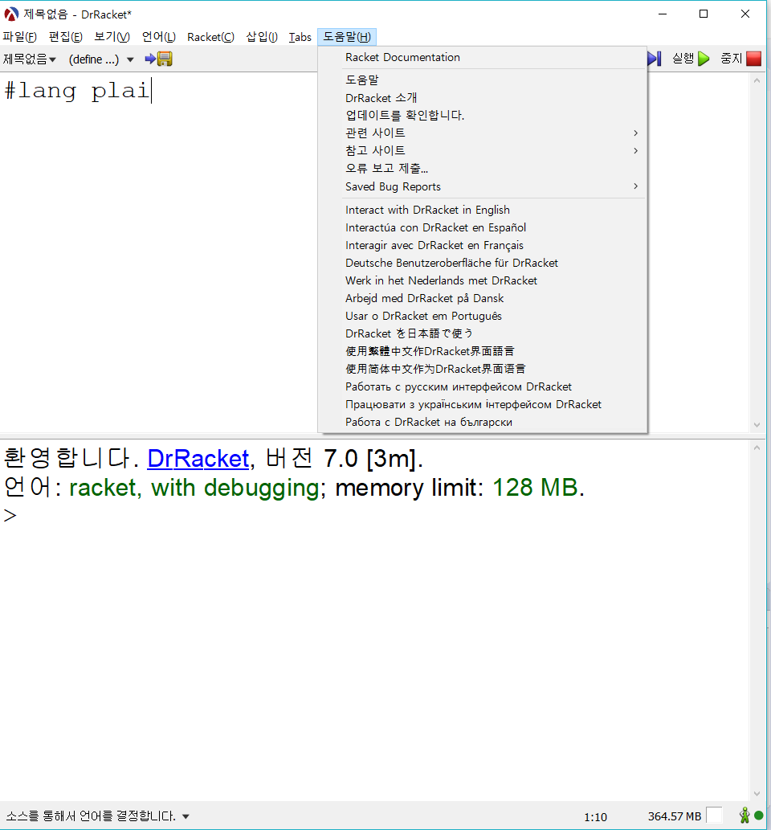
DrRacket (2)
Use DrRacket in English

Slide 27
Racket basic syntax
(operator operand₁ operand₂ …) ; expression/block/statement (+ 1 2) ; Summate 1 and 2
;; Define a function, 'jc'' with a parameter 'b' and its body summantes 1 and 'b' (define (jc b) (+ 1 b))
;; jc 3! (jc 3)

Slide 28
Basic programming language elements
Numbers and Arithmetic
In Racket, numbers can be integers, rationals, reals, or complex. 42 22/7 3.141 2+3i
Arithmetic operations with operators and various arguments (opr args1 …) (ftn args1 …)

Slide 29
Basic programming language elements
Numbers and Arithmetic
In Racket, numbers can be integers, rationals, reals, or complex. 42 22/7 3.141 2+3i
Arithmetic operations with operators and various arguments: (+ 1 2 3 ) (- 5.1 4) (/ 22 7) (modulo 23 3) (max 1 4 3 5 6) (min 2 5 3 4 5) (abs -6) (sqrt 4) ...
https://docs.racket-lang.org/reference/generic-numbers.html#%28part._.Arithmetic%29

Slide 30
Basic programming language elements
Variables and Functions (define (function-name param₁ …) ; define a function body) (function-name args1 … ) ; call the function

Slide 31
Basic programming language elements
Variables and Functions
A square of side-length a has the area a² (define (area-of-square a) (* a a)) (area-of-square 5) (area-of-square 3)

Slide 32
Basic programming language elements
Variables and Functions
A disk of radius r has the approximate area 3.14⋅r² (define (area-of-disk r) (* 3.14 (* r r))) (area-of-disk 5) (area-of-disk 3)

Slide 33
Basic programming language elements
Variables and Functions
Design the function for the area of a ring

Slide 34
Basic programming language elements
Variables and Functions
Design the function for the area of a ring ; area-of-ring: number number -> number ; to compute the area of a ring whose radius is ; outer and whose hole has a radius of inner ; (area-of-ring 5 3 ) should produce 50.24 (define (area-of-ring outer inner) (- (area-of-disk outer) (area-of-disk inner)))
[Contract] [Purpose]
[Example] [Header] [Body]

Slide 35
Basic programming language elements
Variables and Functions
Design the function for the area of a ring ; area-of-ring: number number -> number ; to compute the area of a ring whose radius is ; outer and whose hole has a radius of inner (define (area-of-ring outer inner) (- (area-of-disk outer) (area-of-disk inner))) (test (area-of-ring 5 3) 50.24)
[Contract] [Purpose]
[Header] [Body] [Tests]

Slide 36
Basic programming language elements
Conditional Expressions
Booleans and relations (and (> 4 3) (<= 10 100)) (or (> 4 3) (= 10 100)) (not (= 2 3 ))

Slide 37
Basic programming language elements
Conditional Expressions
Booleans and relations
Functions that test conditions ;; [contract] is-5?: number -> boolean ;; [purpose] to determine whether n is equal to 5 (define (is-5? n) (= n 5)) (test (is-5? 5) true) (test (is-5? 7) false) (test (is-5? 8) false)

Slide 38
Basic programming language elements
Conditional Expressions
Booleans and relations
Functions that test conditions ;; is-between-5-6-or-over-10?: number -> boolean ;; to determine whether n is between 5 and 6 ;; (exclusive) or larger than or equal to 10 (define (is-between-5-6-or-over-10? n) (or (and (< 5 n) (< n 6)) (>= n 10)))

Slide 39
Basic programming language elements
Conditional Expressions
Booleans and relations
Functions that test conditions ;; is-between-5-6-or-over-10?: number -> boolean ;; to determine whether n is between 5 and 6 (exclusive) ;; or larger than or equal to 10 (define (is-between-5-6-or-over-10? n) (or (is-between-5-6? n) (>= n 10))) ;; is-between-5-6-or-over-10?: number -> boolean ;; to determine whether n is between 5 and 6 (exclusive) (define (is-between-5-6? n) (and (< 5 n) (< n 6)))

Slide 40
Basic programming language elements
Conditional Functions (define (function-name param₁ …) (cond [ce₁ body₁] … [else body]))

Slide 41
Basic programming language elements
Conditional Functions Suppose the bank pays 4% for deposits of up to $1,000 (inclusive), 4.5% for deposits of up to $5,000 (inclusive), and 5% for deposits of more than $5,000. Write the function interest-rate which calculates the interest rate for a given amount.

Slide 42
Basic programming language elements
Conditional Functions Suppose the bank pays 4% for deposits of up to $1,000 (inclusive), 4.5% for deposits of up to $5,000 (inclusive), and 5% for deposits of more than $5,000. Write the function interest-rate which calculates the interest rate for a given amount. ;; interest-rate : number -> number ;; to determine the interest rate for the given amount (define (interest-rate amount) …) … (test (interest-rate 1000) 0.040) (test (interest-rate 2000) 0.045)

Slide 43
Basic programming language elements
Conditional Functions Suppose the bank pays 4% for deposits of up to $1,000 (inclusive), 4.5% for deposits of up to $5,000 (inclusive), and 5% for deposits of more than $5,000. Write the function interest-rate which calculates the interest rate for a given amount. ;; interest-rate : number -> number ;; to determine the interest rate for the given amount (define (interest-rate amount) (cond [(<= amount 1000) 0.040] [(<= amount 5000) 0.045] [(> amount 5000) 0.050])) (test (interest-rate 1000) 0.040) (test (interest-rate 2000) 0.045)

Slide 44
Basic programming language elements
Conditional Functions Suppose the bank pays 4% for deposits of up to $1,000 (inclusive), 4.5% for deposits of up to $5,000 (inclusive), and 5% for deposits of more than $5,000. Write the function interest-rate which calculates the interest rate for a given amount. ;; interest-rate : number -> number ;; to determine the interest rate for the given amount (define (interest-rate amount) (cond [(<= amount 1000) 0.040] [(<= amount 5000) 0.045] [else 0.050])) (test (interest-rate 1000) 0.040) (test (interest-rate 2000) 0.045)

Slide 45
Basic programming language elements
Symbols
A symbol is an identifier preceded by a single forward quotation mark: 'the 'dog 'cat 'two^3 'and%so%on?
Only one basic operation on symbols: symbol=? (define (reply s) (cond [(symbol=? s 'GoodMorning) 'Hi] [(symbol=? s 'HowAreYou?) 'Fine] [(symbol=? s 'GoodAfternoon) 'INeedANap] [(symbol=? s 'GoodEvening) 'BoyAmITired]))

Slide 46
Then, how we can design a program?

Slide 47
Steps to Good Programming

Slide 48
The Design Recipe for functions
Contract (Signature) ; area-of-ring: number number -> number
Purpose ; to compute the area of a ring whose radius is ; outer and whose hole has a radius of inner
Tests (test (area-of-ring 5 3) 50.24)
Header (define (area-of-ring outer inner)
Body (- (area-of-disk outer) (area-of-disk inner)))

Slide 49
Test-Driven Development
Write test cases before writing programs.
Write the simplest code to pass those tests.
If your code doesn't do everything you want it to, write more tests and repeat.

Slide 50
Test-Driven Development (2)
Code and Tests are two wheels in a bike.
Tests are a great source of documents.
Precise
Executable and always in sync with code
Help us keep the design simple.
Help us make incremental progress.
Protect our code!!!

Slide 51
Test-Driven Development (3)
Testing in Racket with the PLAI setting
(test result_expression expected_expression) (test (area-of-square 4) 16) produces good (area-of-square 4) "at line 3" expected: 16 given: 16
(test/exn result_expr error_message) (test/exn (error "/: division by zero") "by zero")
(test/pred result_expr pred?)
(test/regexp result_expr error_message_regexp)
http://docs.racket-lang.org/plai/plai-scheme.html

Slide 52
More resources
http://plrg.kaist.ac.kr/doku.php?id=home:lectures:cs320_2018_2
http://www.cs.brown.edu/courses/cs173/2008/
http://pl.barzilay.org/
http://www.eng.utah.edu/~cs5510/f09/
http://users.eecs.northwestern.edu/~robby/courses/395-2010-winter/

Slide 53
JC jcnam@handong.edu https://lifove.github.io
* Slides are from Prof. Sukyoung Ryu's PL class in 2018 Spring or created by JC based on the main text book.

